Slide 1
MACHINE LEARNING FOR CLINICAL CARE AND RESEARCH AT INTERMOUNTAIN
You can predict the future.
So what?
Moving from predictions to action
Brian Locke, MD, MSCI | Pulmonary & Critical Care Grand Rounds | Intermountain Medical Center
June 2, 2026
Disclosure: Relevant financial relationship. Equity Mountain Biometrics (MTN), non-clinical AI related to data harmonization.

Slide 2
INTRODUCTION
Predictions are purportedly accurate
Clinical impact generally remains … disappointing?
THE PROMISE
THE REALITY
Impressive prediction.
Few are as accurate as claimed.
Few models can be used at bedside.
Few change decisions.
?
Notes:
Purpose: Anti-hype slide that separates model performance from clinical impact.
Key line: AUC is upstream of the endpoint we actually care about.
Transition: Now name the hard question.
Source anchors: A Few Good Metrics; STRATOS TG6 / Van Calster et al.
Can you recenter the AUC curve in the box?

Slide 3
CME QUESTION | RISK MODELS
A properly used risk model can improve an RCT by:
Select the best answer
A
Enriching the population of interest, thereby making the trial more efficient
B
Allowing more efficient estimation of the treatment-effect size
C
Enabling more personalized application of treatment-effect estimates to individual patients
D
All of the above

Slide 4

INTRODUCTION
You can predict the future. So what?
Prediction
Purpose
Action
Impact
risk, class, outcome
→
the bottleneck
→
change a decision
→
better care / research
Notes:
Purpose: Establish the organizing question for the whole talk.
Key line: The hard question is not whether a model predicts; it is what the prediction is for.
Transition: Introduce the four answers, but keep this slide focused on purpose.
Source anchors: Current deck opening; rebuild ticket.

Slide 5
ROADMAP
Four ways to make use of good predictions
ACT
LABEL
Target attention or treatment when expected benefit exceeds burden
Build the reference class that matches the clinical decision
ENRICH
ESTIMATE
Choose who and what to study so the trial can learn
Preserve randomization while removing predictable noise
Notes:
Purpose: Present the only taxonomy used in the deck.
Key line: Prediction earns its keep when it does one of four jobs: act, label, enrich, or estimate.
Transition: Start with Act using the Wells Score.
Source anchors: Rebuild ticket; current taxonomy slide.

Slide 6
ACT | MACHINE LEARNING
ML finds the map from predictors to an outcome
Predictors
Algorithm
Output
age, vitals, labs
→
learns the mapping
→
classification or regression
Learn relationships in one set of observations, apply to new ones.
Notes:
Purpose: Bridge familiar clinical rules to machine learning without teaching model classes.
Key line: Machine learning is not synonymous with neural networks.
Transition: PE diagnosis created a narrow action problem.
Source anchors: View from the MTN ML article; Wells Score background.

Slide 7
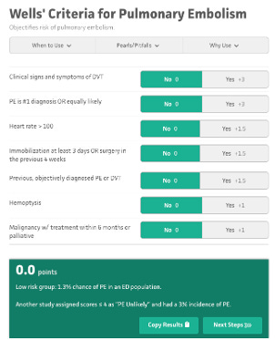
ACT | MACHINE LEARNING
Fit a best-fit line (in log-odds space) → probability
log-odds
rule-out
rule-in
P = 1
logit⁻¹
→
p = β₀ + β₁x₁ + β₂x₂
P = 0
linear predictor (η)
linear predictor (η)
No one does this math at the bedside… except you do.
Notes:
Purpose: Anchor Wells in a specific action, not diagnosis in the abstract.
Key line: The useful question was who can safely avoid CT.
Transition: Show how Wells became a workflow.
Source anchors: Wells Score background; current Wells section.

Slide 8
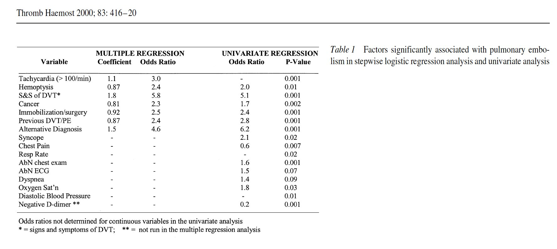
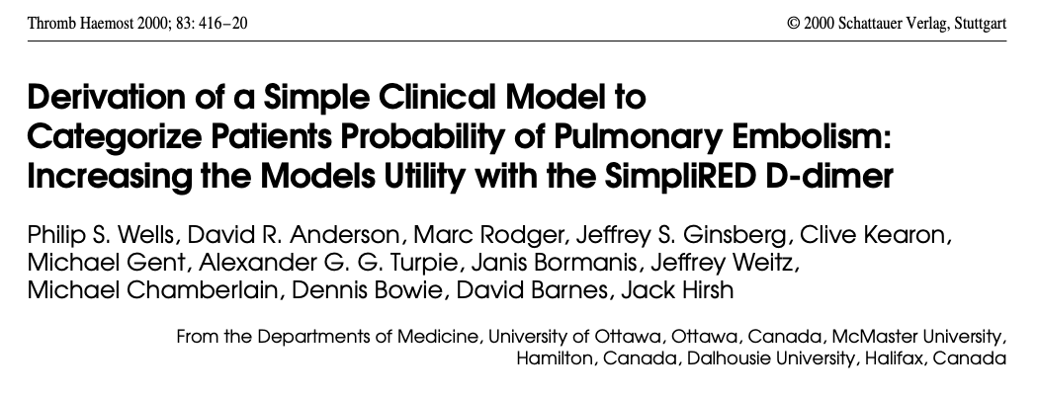
ACT | MACHINE LEARNING
Wells: regression coefficients → point score
Round the coefficients and pick points that line up with decision thresholds = score
Wells et al., Thromb Haemost 2000;83:416–20.
Notes:
Purpose: Compress Wells history into the development pathway that made it usable.
Key line: Wells worked because it became a validated workflow.
Transition: Reduce the mechanics to one logistic-regression slide.
Source anchors: Wells et al. 2000; View from the MTN Wells article.

Slide 9
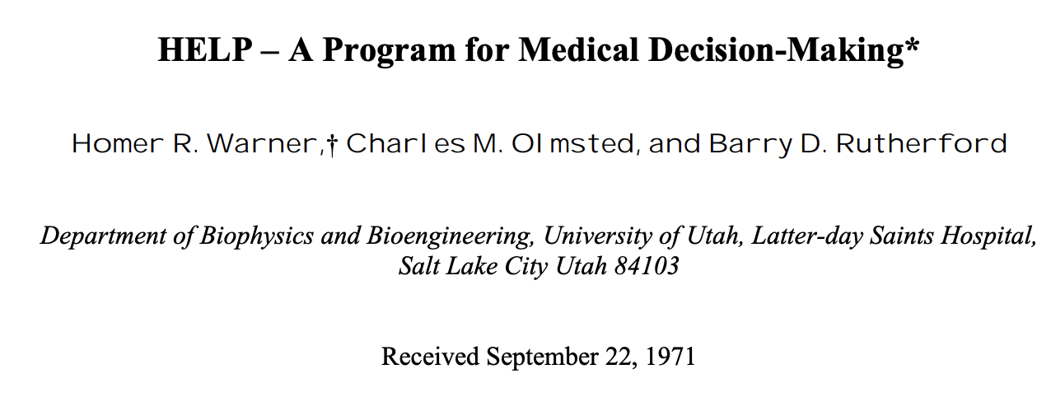
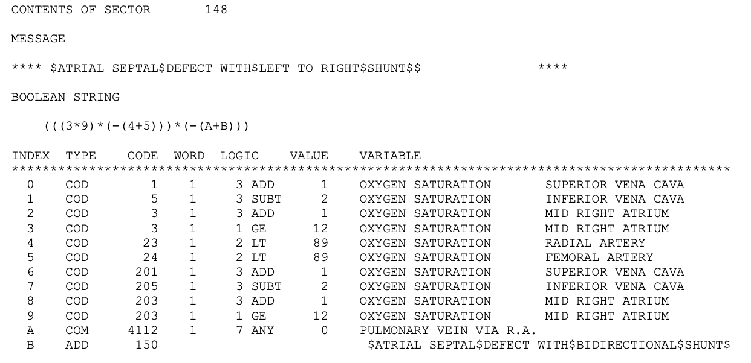
ACT | MACHINE LEARNING
Intermountain: bedside decision support in 1967
At LDS Hospital, HELP captured coded clinical data into a shared patient record, applied modular medical logic, and returned patient-specific diagnoses, alerts, reminders, and treatment recommendations.
Capturing data for machine learning was the original motivation for the EHR.
Notes:
HELP was not modern machine learning. It was earlier and arguably more operationally mature: a coded clinical database plus executable medical knowledge. It used deterministic if-then logic, Bayesian probability calculations, temporal rules, monitoring logic, and explanations to support real decisions in cardiology, ICU care, radiology, pharmacy, laboratory interpretation, infection surveillance, and antibiotic management.

Slide 10
CLINICAL PREDICTION MODELS
Statistical learning is embedded in routine care
Clinical tools convert observed features into estimates, categories, or action thresholds.
Wells score
eGFR
Apgar
Framingham risk
Findings + history
→ weighted rule
→ probability estimate
Creatinine + demographics
→ regression model
→ kidney estimate
Observed signs
→ composite score
→ transition status
Risk factors + labels
→ cohort model
→ treatment threshold
Notes:
Purpose: Introduce the reference-class problem.
Key line: A diagnosis is useful if the class helps predict prognosis, mechanism, treatment response, or routing.
Transition: Define fitness for purpose.
Source anchors: Current reference-class section; K23 framing memory.

Slide 11
RECAP
Machine learning for clinical decisions
ML learns patterns
Good ML is embedded
It already has impact
Machine learning finds mapping from predictors to an output.
It quietly underlies much of usual practice
Though perhaps not as much as it could (should)
ML can be used for things other than clinical decision support.

Slide 12
PRAGMATIC NOSOLOGY
Prediction for Condition labels
Classification draws useful boundaries around physiology… pragmatic constructs
Explain the present
Make symptoms, signs, or abnormal findings cohere.
Predict the future
Estimate risk of clinically important outcomes.
Guide action
Identify who benefits enough to treat, monitor, or route.
Disease categories are tools, not natural kinds (usually).
Boundaries are drawn across continuous physiology when the grouping helps describe, predict, or guide action.
Stegenga 2018; Doust et al., JAMA Intern Med 2017; Ranieri et al., AJRCCM 2022; Carrell et al., JAMIA 2025
Notes:
Purpose: Reframe disease definitions as purposeful scientific and clinical tools. Key line: A disease definition is not simply a mirror of nature; it is a tool that must be judged against a job. Transition: Once the purpose is explicit, separate definitions based on present abnormality from those based on future risk. Source anchors: Stegenga; Doust et al.; Ranieri et al. AJRCCM 2022; Carrell et al. JAMIA 2025.

Slide 13
LABEL DESIGN
Cutpoints and risk thresholds serve different purposes
Use abnormality labels to describe observed state; use risk labels to justify action.
Abnormality label
Risk / action label
How far from a reference state?
When is action worth taking?
HLD
LDL-C above a cutpoint labels a lipid abnormality.
Ten-year ASCVD risk estimates likely benefit from statin treatment.
Lung nodule
Size and morphology label an imaging abnormality.
Estimated malignancy risk determines surveillance, PET, biopsy, or resection.
Notes:
Purpose: Contrast abnormality-based and risk-based disease definitions. Key line: Abnormality asks what is unusual now; risk asks what future harm is likely. Transition: Use hyperlipidemia as the familiar example of this shift. Source anchors: Stegenga; Aronowitz Risky Medicine; Doust et al. JAMA Internal Medicine 2017.

Slide 14
GUIDELINE CASE
2013 ACC/AHA: used risk prediction to make cholesterol labels action-oriented
LDL-C abnormality label
Statin-benefit action class
Classifies a measurement Work: description
Classifies expected benefit Work: treatment threshold
Sources: ATP III; 2013 ACC/AHA cholesterol guideline; Pooled Cohort Equations
Notes:
Purpose: Use cholesterol to show the shift from biomarker abnormality toward preventable event risk and expected benefit. Key line: The question moved from is the LDL high to is this patient's absolute ASCVD risk high enough that lipid lowering is worth it. Transition: This is not only philosophical; the screening math makes risk central to action. Source anchors: ATP III; 2013 ACC/AHA Blood Cholesterol Guideline; Pooled Cohort Equations.
Purpose of a HLD label is really just to indicate you should be on medications to improve your risk profile.

Slide 15
ACT | RISK-BASED
Baseline risk is a ceiling on benefit
Calipers mark the only group that can possibly benefit
remaining patients would never have the outcome
~33
High risk
would get outcome
would never have outcome
~33%
~15
Medium risk
~15%
~5
Low risk
~5%
You can only prevent an outcome that was going to happen.
Kent 2023
Notes:
Purpose: Show why risk-based definitions are advantageous for guiding action by using screening math. Key line: Baseline risk is not background information; it determines predictive value, yield, and false-positive burden. Transition: This same logic motivates transition-care phenotypes: the useful HRF label should route scarce post-discharge attention. Source anchors: Bayes theorem; diagnostic threshold logic; screening PPV example.

Slide 16
ACT | RISK-BASED TREATMENT
Preventive care has cruel base-rate math
Before the outcome happens, most people cannot benefit; everyone touched can still be burdened.
Treatable few
Would not have event anyway
Event despite action
Burden scales with everyone touched
Benefit scales with the preventable few
outreach, testing, false positives, anxiety, tx burden
avoided admissions, events, or deaths
ARR = baseline risk x relative risk reduction; NNT = 1 / ARR
Earlier action lowers the base rate; benefit:harm math becomes unforgiving.
Sources: Welch & Passow, JAMA Intern Med 2014; Welch, Schwartz & Woloshin

Slide 17
CARE STRATEGY
Proactive care has two viable paths
Unless action nearly harmless, the population must be selected by expected benefit.
Intermountain priority: act before avoidable deterioration
1 Stay harmless
2 Target preventable risk
3 Failure mode
Deploy broadly only when actions are safe, cheap, and low-burden.
Use models when action carries cost, harm, or capacity burden.
Treating everyone lets harms and costs accumulate.
Action threshold: expected benefit > harm + cost + capacity burden
Modeling matters because proactive care is earlier care under uncertainty.

Slide 18
ACT I | USUAL CARE
Risk scores already route some patients into proactive care
Prediction
Triage
Navigator Help
Claims, utilization history, diagnoses, and demographics feed a Predictive Risk Model that flags high- or rising-risk members.
Members are routed to care coordination or management.
Care gaps, social determinants (SDoH), transitions, and escalation.
What this looks like operationally
Coordinators organize care, navigate benefits, and connect patients to preventive and social-needs support.
Notes:
Purpose: Make the clinical operations analogy concrete and professional on slide.
Key line: AI can expand the range of questions we can act on quickly and reasonably.
Transition: Then define the comparator as the available care system.
Source anchors: Current slide 30; ASCEND-MA framing.
Oral bridge: My girlfriend gives me a hard time when I use AI to do things I probably would have spent the time to think through myself. That critique is basically right: that can become cognitive outsourcing. The more useful pattern is different. AI lets me look into things I would otherwise shrug off because I lack the time, confidence, or activation energy to investigate them. It expands the sphere where I can act quickly and reasonably.
Pivot: That is the clinical operations analogy. The sickest patients are often already visible. AI may be most useful when it expands care-team attention into the rising-risk middle.

Slide 19
ASCEND-MA Trial
AI-Supported Care Engagement for Next-step Delivery
— Medicare Advantage
Study team: Joseph Kamerath, MD (PI); Brian Locke, MD; Haya Khalaf, RN;
Kate Minick, PhD; Samuel Brown, MD
Can prediction extend preventive attention to patients
not yet reached by usual care?
Notes:
Purpose: Show ASCEND-MA as implementation case study.
Key line: The outcome is not AUC; the outcome is operational, clinical, and economic impact.

Slide 20
ASCEND-MA tests risk targeting under capacity constraints
The comparator is the best available workflow, not an ideal clinician.
Current risk-targeting infrastructure
Why supervised AI is plausible here
High-risk CM
high-touch support
Capacity constraint
Teams can't review the full rising-risk panel.
Rising-risk middle
PRM RR ≥0.70; CR <0.95
≥30% predicted YoY cost growth
not yet in high-risk CM
Targeting problem
Reach preventable, unattended risk.
Base-rate constraint
Broad MA population
routine care + low-intensity outreach
Expand reach only when benefit justifies burden.

Slide 21
ACT I | ASCEND-MA INTERVENTION
Can supervised AI can extend proactive attention earlier
The comparison is AI-supported review versus finite human bandwidth: not AI versus ideal care.
Targeting premise
Can a lower-intensity, reviewed workflow reach rising-risk patients before escalation?
1
2
3
4
Risk model flags member
AI drafts 1–4 care gaps
RN accepts, modifies, or rejects
Nudge sent
Notes:
Purpose: Shift from treatment rules to operations.
Key line: The target is not simply highest risk; it is risk times modifiability times usual-care miss probability.
Transition: Use the AI sphere-of-action slide to make the operations analogy.
Source anchors: ASCEND-MA framing; prior deck slide 27.
We should also include that the nudges can occur several times over the 90 day period. (1-4x per the protocol) - this could be represented with an arrow back to 2 from 4.

Slide 22
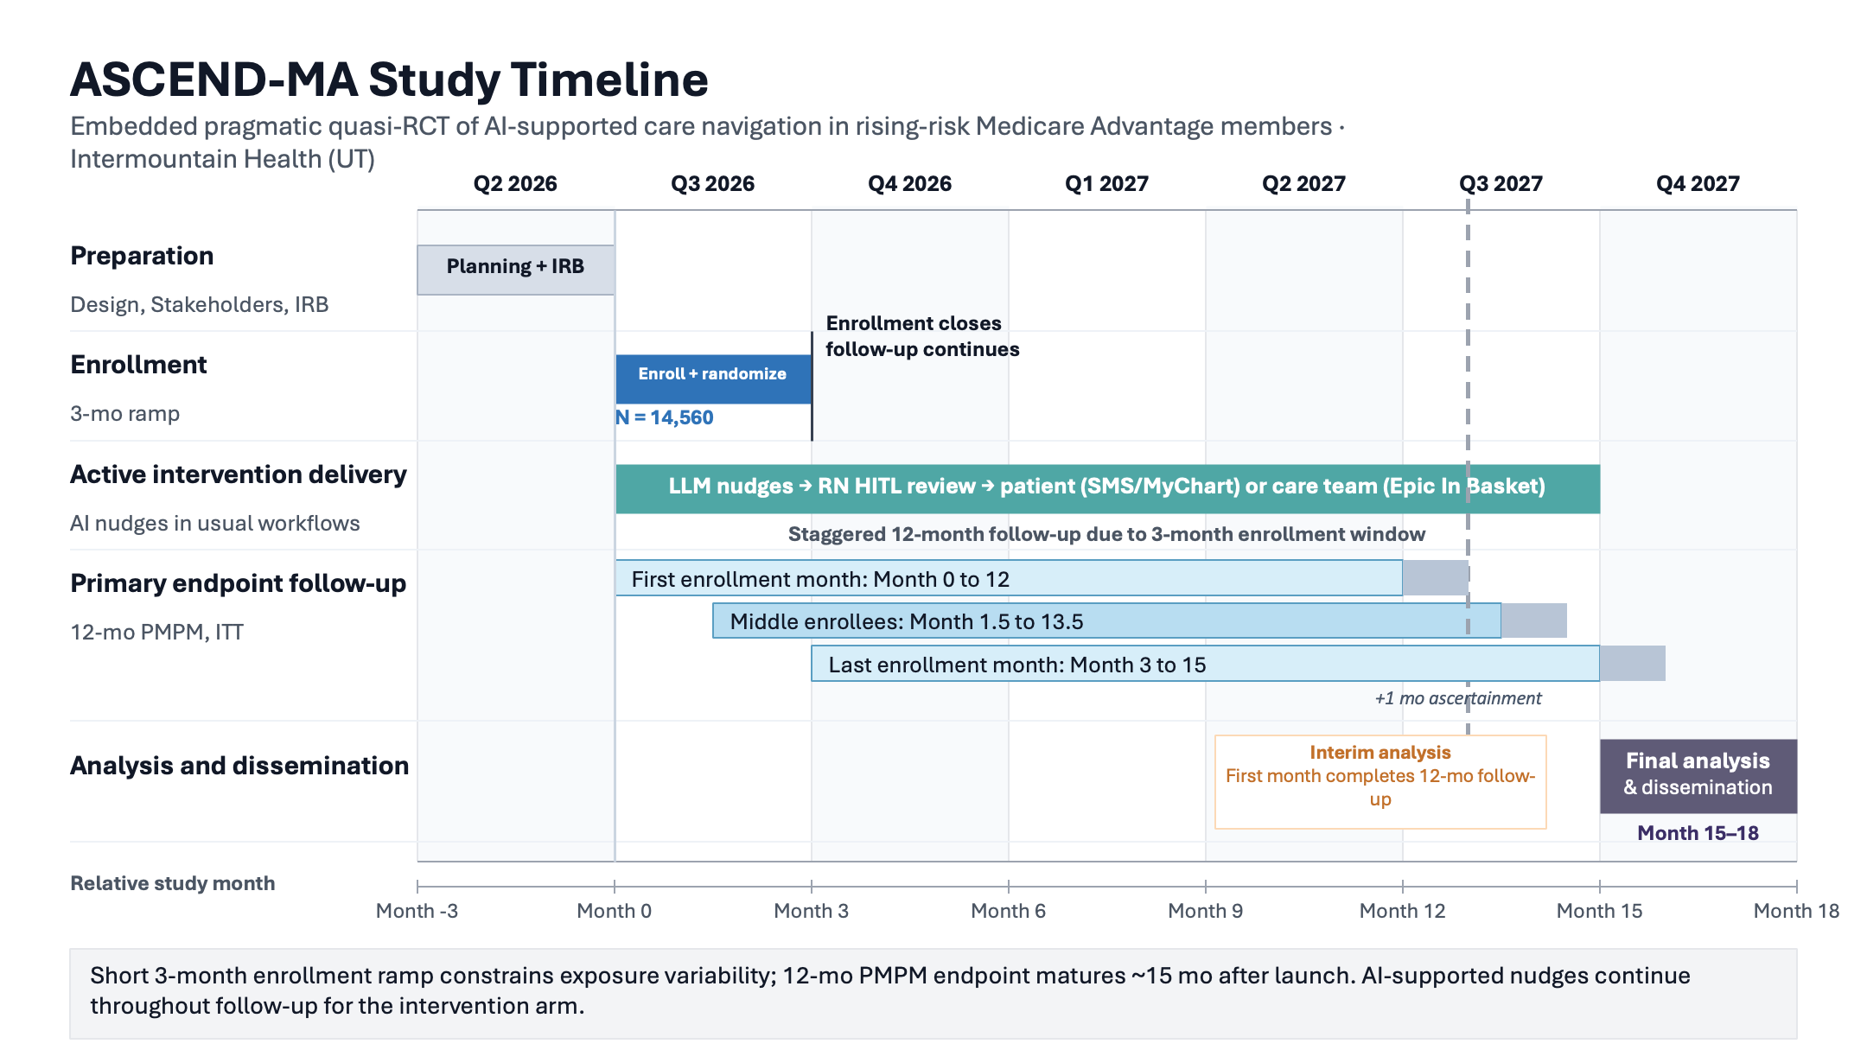
PROTOCOL DESIGN · ASCEND-MA
Trial design at a glance
EXCLUSION CRITERIA
In high-risk CM at index, hospice/EOL, or insufficient scoring history.
QUASI-RANDOMIZATION
MRN parity (1:1) assignment; ITT primary analysis.
PRIMARY OUTCOME
12-mo medical spend
SECONDARY (PULMONARY)
COPD deterioration
ANALYSIS
ITT vs usual care
Notes:
Purpose: Define prognostic enrichment cleanly.
Key line: Enrichment does not require predicting who responds.
Transition: Critical care trials especially need signal.
Source anchors: Current trial enrichment slide; Kent/prognostic enrichment framing.

Slide 23
ASCEND-MA | WHY EVALUATE NOW
Adoption is coming either way — design now to learn whether it helps
1
Adoption is happening
2
Narrow design window
3
A cautionary precedent
AI tools are spreading across the organization for many reasons, and will expand as models improve.
Moving early lets us build causal-inference design in before adoption is locked in everywhere.
“Hotspotting” looked transformative — until the RCT showed regression to the mean. Enthusiasm is not evidence.
Design the evaluation now and we learn which AI workflows truly help and which should be discouraged or de-adopted.
Cautionary precedent: Camden Coalition hotspotting RCT (Finkelstein et al., NEJM 2020).

Slide 24
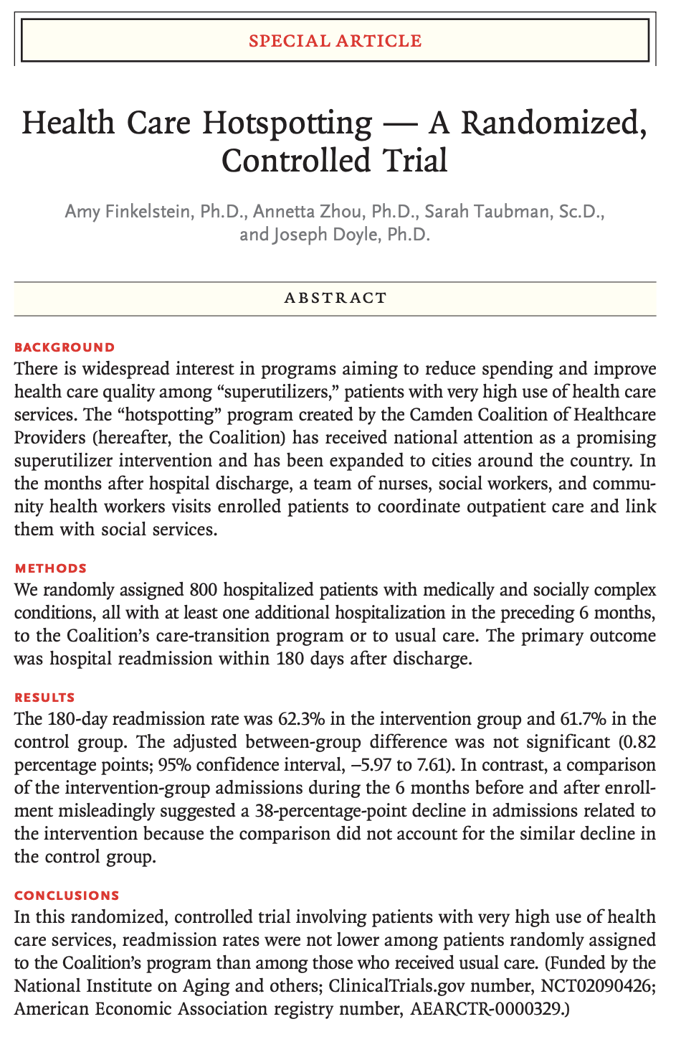
ASCEND-MA | CAUTIONARY PRECEDENT
Hotspotting looked transformative — until it was randomized
THE EXCITEMENT
Intensive care management for super-utilizers showed steep drops in admissions and cost in before-after data.
vs
THE CONTROLLED REALITY
The Camden Coalition RCT found no reduction in 180-day readmissions versus usual care.
Why it failed: patients enter at a peak and many improve anyway… without a control arm, regression to the mean looks like impact.
Source: Finkelstein et al., Health Care Hotspotting — A Randomized, Controlled Trial. N Engl J Med 2020;382:152-162.

Slide 25
AIM-HIGH: Intermountain-SelectHealth
Inpatient-Outpatient Transition for Patients with Hypercapnic Respiratory Failure
AIM-HIGH study team: Brian Locke, David Hedges, Rylan Fowers, Nick Green, Samuel Brown
K23:
Aim 1: Develop and temporally validate automated discharge-risk estimates Aim 2: Compare early EHR, discharge EHR, and claims-augmented predictor sets Aim 3: Test whether target choice changes capacity-limited triage panels
Notes:
Purpose: Show ASCEND-MA as implementation case study.
Key line: The outcome is not AUC; the outcome is operational, clinical, and economic impact.

Slide 26
RATIONALE | HYPERCAPNIC RF TRANSITION
Hypercapnic respiratory failure is high-burden — and these patients are under-evaluated
~1 in 3
~10×
readmitted within 30 days (national)
age-expected mortality (national)
COST BURDEN · PLAN-PAID PER-MEMBER-PER-MONTH (n=5,624, first hypercap RF hospitalization, 2016–2024)
Early baseline
Pre-index 3 mo
Index month
Post-index 3 mo
$3,571/mo
$6,311/mo
$50,084
$6,121/mo
months −12 to −4
+77% vs baseline
≈14× baseline · 84% inpatient
+71% vs baseline
Locke et al., ATS 2026 — SelectHealth/Intermountain cohort, 2016–2024; nominal insurer-paid claims.
Cause Seldom Investigated
31% PFTs, 21% Sleep study 5y before; 15% PFTs, 10% Sleep study 1y after.
Notes:
Purpose: Preview K23 without turning this section into a grant pitch.
Key line: HRF can be defined physiologically, but transition care needs a routing class.
Transition: Recap the Label answer, then move to risk-based action.
Source anchors: Locke K23 Specific Aims; prior deck framing.

Slide 27
RISK TARGETING | LATENT VENTILATORY FRAILTY
Latent Ventilatory Frailty flags a high-risk, under-tested care gap
WILSON ET AL.
MERDAD ET AL.
PROPOSED LABEL
1 Risk signal
2 Presentation context
3 LVF phenotype
PCO₂ >50 with normal pH identified a high-risk hospitalized cohort.
Respiratory concerns were enriched in coded or compensated hypercapnia.
High HCO₃⁻ + above-borderline PCO₂ may reveal an unoptimized care gap.
44% died over median 592 days; adj. HR 1.09 per +5 mmHg.
ICD-positive: 50% respiratory; physiologic criteria broader.
No recent PFT, sleep evaluation, or NIV review = actionable.
ML optimization
Learn the best threshold combination, quantify predictor strength, and validate LVF as an actionable risk label.
Sources: Wilson et al., Ann Am Thorac Soc 2021; Merdad et al., manuscript draft. LVF proposed; validation needed.
Notes:
Purpose: Anchor the K23 in a clinical transition gap.
Key line: HRF transition care is the pulmonary application of reference-class and attention-routing logic.
Transition: Show the three-aim sequence.
Source anchors: Locke K23 Specific Aims.
Required guardrail: HRF transition care is the pulmonary/critical care application of reference-class and attention-routing logic.

Slide 28
APPLY | K23 ROADMAP
Transition-care evidence cycle for Hypercap RF
Aim 1
Aim 2
Aim 3
Measure variation Labeling, testing, equipment/med review, referral, follow-up across IH.
Validate at-discharge risk model for repeat utilization, overall cost, care-burden
Test feasibility of Navigator assessment for prespecified high-risk patients
K23 products: train a health-services research expert in chronic respiratory failure care transitions, as well as planning data for effectiveness trial of risk-targeted care navigation.
Notes:
Purpose: Make the grant sequence legible.
Key line: Measure current care, validate risk infrastructure, then test feasibility before R01.
Transition: Clarify Aim 2 is not deployment.
Source anchors: Locke K23 Research Strategy.
Required guardrails: Aim 2 validates risk infrastructure, not a deployed tool. Aim 3 enrollment is criteria-based and independent of Aim 2 model performance.

Slide 29
AIM 2 | RISK INFRASTRUCTURE
Aim 2 validates post-discharge risk infrastructure for future trials
Inputs before discharge
Interpretable model
Planning endpoints
recognition route, labs, comorbidities, prior use, discharge needs
→
validate/recalibrate interpretable time-to-event model
→
readmission, HRF acute care, death; 30/90-day risk
Planning use: enrichment, stratification, endpoint capture, and navigator-capacity scenarios — not deployment.
Notes:
Purpose: Guard against overclaiming model deployment in the K23.
Key line: Aim 2 validates research-ready risk infrastructure; it is not a clinical deployment tool.
Transition: Clarify Aim 3 is feasibility, not efficacy.
Source anchors: Locke K23 Specific Aims / Research Strategy.
Required guardrail: Aim 2 validates risk infrastructure, not a deployed tool.
This one seems a little too much like the prior one in terms of layout.

Slide 30
AIM 2 | PREDICTION TARGETS
Prediction starts at discharge time-zero
Entry: ABG PaCO₂ >45, VBG PCO₂ >50, or ICD HRF codes → discharge = time zero (pre-routing)
Primary
Utilization
Cost
Clinical failure: death or unplanned readmission
Acute-care use
1-year postdischarge cost
Different futures may select different patients – Overlap (or not) is a key question
Locke HRF discharge-risk manuscript draft
Notes:
Purpose: Guard against overclaiming model deployment in the K23.
Key line: Aim 2 validates research-ready risk infrastructure; it is not a clinical deployment tool.
Transition: Clarify Aim 3 is feasibility, not efficacy.
Source anchors: Locke K23 Specific Aims / Research Strategy.
Required guardrail: Aim 2 validates risk infrastructure, not a deployed tool.

Slide 31
AIM 2 | MODEL CONSTRUCTION
Predictor sets test how much information is enough
Information available by routing time
Set 1 · Early structured EHR
Set 2 · Discharge-available EHR
Set 3 · Claims + finalized discharge
Recognition-stage risk
Primary scalable model
Approximate upper bound
Model-development spine
Model class LASSO / elastic-net Cox
Calibration Hazard at 30 · 90 · 365 d
Evaluation Discrimination · Brier · yield
Temporal validation: 2016–2021 develop → 2022 tune + lock → 2023–2024 temporal test
Evaluate the model where routing decisions would actually be made.
Notes:
Purpose: Guard against overclaiming model deployment in the K23.
Key line: Aim 2 validates research-ready risk infrastructure; it is not a clinical deployment tool.
Transition: Clarify Aim 3 is feasibility, not efficacy.
Source anchors: Locke K23 Specific Aims / Research Strategy.
Required guardrail: Aim 2 validates risk infrastructure, not a deployed tool.

Slide 32
OPTIONAL BRIDGE | MODEL USE
The risk model’s first job is for trial design
Validated risk estimates make the next trial feasible — where risk, actionability, and capacity meet.
1. Enrich the cohort
2. Stratify the trial
3. Size the workflow
Increase expected event yield for readmission, HRF acute care, or death after discharge.
Balance arms and prespecify risk strata without treating a score as an indication.
Estimate top-N weekly review lists, site volume, and navigator/RT capacity needs.
Notes:
Purpose: Anchor the K23 in a clinical transition gap.
Key line: HRF transition care is the pulmonary application of reference-class and attention-routing logic.
Transition: Show the three-aim sequence.
Source anchors: Locke K23 Specific Aims.
Required guardrail: HRF transition care is the pulmonary/critical care application of reference-class and attention-routing logic.

Slide 33
AIM 3 | FEASIBILITY TRIAL
Aim 3 tests whether structured assessment is feasible in high-risk HRF transitions
Prespecified high-risk group
Navigator assessment
Feasibility readouts
HRF diagnosis code + no prior PFT/sleep study + prior respiratory exacerbation
→
care gaps, etiology clues, barriers, equipment/medications, follow-up needs
→
reach, fidelity, acceptability, burden, barriers, 90-day indicated testing
Embedded randomized feasibility trial: 40 patients, 3 sites.
Estimates workflow requirements, not clinical effectiveness.
Notes:
Purpose: Keep Aim 3 as feasibility rather than a full grant pitch.
Key line: Aim 3 tests whether a pathway can reliably route patients to indicated care.
Transition: Return to the four answers and close.
Source anchors: Locke K23 Specific Aims / Reapplication.
Required guardrails: Aim 3 enrollment is criteria-based and independent of Aim 2 model performance. Aim 3 is feasibility, not efficacy.

Slide 34
TRIAL APPRAISAL | PREDICTION MODELS
Prediction models help interpret trials across design, estimates, and application
Pivot from model performance to trial usefulness
DESIGN
ESTIMATE
APPLY
Enrich the trial population
Improve effect-size estimation
Personalize interpretation
Target patients most likely to have events or benefit.
Reduce noise and improve precision around effect estimates.
Translate average trial effects to individual patients.
Appraisal lens
Ask whether the model changes who is studied, how effects are estimated, or how results should be applied.

Slide 35
ENRICH | TRIAL DESIGN
Binary-endpoint trials often cannot see effects that would still change care
When plausible benefits are small, trial design must recover information through enrichment, better endpoints, or both.
1 Mortality signal is narrow
2 Small effects need large trials
3 Recover information by design
No mortality contrast
Illustrative: 50% mortality, 80% power.
Risk enrichment
Would live either way
Absolute effect
Approx. N
Enough baseline events
Would die either way
10% ARR
~800
Cleaner case definition
5% ARR
~3,100
Less heterogeneity
Outcome changes because of assignment
2.5% ARR
~12,500
Informative outcomes
1% ARR
~78,000
Trajectory (state-by-day)
The assignment-sensitive group is the signal.
Adjustment
Worthwhile effects can be smaller.
Remove noise
Better prediction concentrates measurement where the outcome is plausible, actionable, and learnable.
Notes:
Purpose: Motivate enrichment and adjustment in PCCM trials.
Key line: When outcomes are noisy, better prediction can improve design before predicting response.
Transition: Now show adjustment as the Estimate job.
Source anchors: Critical care trial design; current slide 42.

Slide 36
ENRICH + ESTIMATE | RESIDUAL VARIATION
Baseline risk helps twice: enrich first, adjust after randomization
BEFORE RANDOMIZATION
AFTER RANDOMIZATION
Enrichment: choose who enters
Adjustment: estimate precisely
Enough baseline risk for outcome capture
Prespecify prognostic baseline covariates
Higher event yield and feasible operations
Explain predictable outcome variation
Avoid broad cohorts with uninformative outcomes
Narrow intervals without changing randomization
Goal: more signal
Goal: less noise / residual variation
Source: Morris et al., Trials 2022 — prognostic covariate adjustment can improve precision.
Notes:
Purpose: Summarize the trial design argument.
Key line: Enrichment chooses who enters; adjustment estimates more precisely after randomization.
Transition: Apply the full logic to the K23 HRF program.
Source anchors: Current slide 45; K23 Aim 2 future-use framing.

Slide 37
ESTIMATE | TEACHING FRAME
Adjustment removes predictable risk
Randomization preserves the contrast; prognostic covariates explain variation that would otherwise blur the treatment signal.
A decomposition to teach before the regression model
Outcome
=
treatment signal
+
baseline risk (predicted)
+
residual variation
1
Keep randomization
2
Predict outcome
3
Compare residuals
Treatment assignment remains independent of baseline risk.
Use only pre-randomization variables to estimate predictable risk.
Smaller residual variation means a smaller SE for the average effect.
Source concept: prognostic covariate adjustment in randomized trials; Morris et al., Trials 2022.
Notes:
Purpose: Introduce prognostic adjustment as precision infrastructure.
Key line: This is precision adjustment in an RCT, not confounding adjustment.
Transition: Quantify the precision payoff.
Source anchors: Senn 2015; trial covariate adjustment literature.
Teaching sequence: intuition, then formula, then numbers. Adjustment is not personalization; it improves estimation of the average randomized effect.

Slide 38
ESTIMATE | R² TO SAMPLE SIZE
Prediction R² is a sample-size dividend
If covariates explain outcome variation, residual variance shrinks and the same precision needs fewer participants.
Model R²
N needed if N=1,000
N saved
Same-n info
Rule of thumb
0.05
950
50
1.05×
n_adj ≈ n_unadj × (1 − R²)
0.10
900
100
1.11×
SE multiplier ≈ √(1 − R²) Same-n information ≈ 1 / (1 − R²)
0.20
800
200
1.25×
0.30
700
300
1.43×
0.40
600
400
1.67×
R² = prognostic variation explained before randomization
0.50
500
500
2.00×
Approximate gains from prognostic covariate adjustment
Example: R² = 0.20 means ~20% fewer participants for the same precision — or the same trial behaves like ~1.25× as much information.
Most literal for continuous outcomes; use as planning intuition otherwise. Source: Morris et al., Trials 2022.
Notes:
Purpose: Give trialists the mathematical payoff.
Key line: If residual SD falls by 20%, SE falls by 20%.
Transition: Close the trial-methods section by linking enrichment and adjustment.
Source anchors: Senn 2015; efficient estimation framing.

Slide 39
ACT | RISK-BASED TREATMENT
A single NNT hides the risk groups decisions need
What gets lost when the average becomes the answer
TRIAL-LEVEL SUMMARY
ARR = 2%
Lower-risk patients
relative effect → small absolute benefit
NNT = 50
Trial average
Control 10% → treatment 8%
one ARR/NNT for the whole enrolled group
Higher-risk patients
relative effect → large absolute benefit
Averages are valid for groups. Personalization can come from risk-defined reference classes, not claimed person-level effects.
Source concept: Kent 2023; PATH statement framing of heterogeneous treatment effects.
Notes:
Purpose: Reframe NNT without dismissing it.
Key line: NNT equals 50 is a population summary, not a patient property.
Transition: Show how baseline risk changes absolute benefit.
Source anchors: Kent 2023; current NNT slide.
[ ] plan to revise this some with the framing from Harrell https://www.fharrell.com/post/rdist/
ARR and NNT conflate baseline risk and treatment effect – not the best way to generalize to other

Slide 40
ACT | RISK-BASED TREATMENT
Baseline risk turns one relative effect into different NNTs
If relative risk reduction is stable, absolute risk reduction still scales with baseline risk.
Baseline risk
RR
Treatment risk
ARR
NNT
2%
0.80
1.6%
0.4%
250
20%
0.80
16%
4%
25
40%
0.80
32%
8%
13
Baseline risk is distributed, not fixed
Uses multivariable baseline risk, not one subgroup at a time.
low risk
high risk
Risk-stratified ARR/NNT can change decisions without searching for responders.
Notes:
Purpose: Show risk magnification of absolute benefit.
Key line: The same relative effect can produce very different ARR and NNT.
Transition: Benefits and burdens may scale differently.
Source anchors: Kent 2023; Harrell risk-magnification framing.
We should add some evidence that actually, RR’s tend to be more stable than other effect measures.

Slide 41
ACT | RISK-BASED TREATMENT
Risk targeting estimates conditional benefit
Not “find the subgroup that responds”; estimate absolute benefit and compare it with burden, harms, and capacity.
1. Predict baseline risk
2. Translate to ARR
3. Target when benefit exceeds burden
Use pre-randomization variables to form a patient-centered reference class.
Apply the trial effect on an interpretable scale; ARR and NNT vary with risk.
Prioritize when expected benefit justifies workload, harms, and scarce capacity.
not one-variable subgroups
absolute scale
decision threshold
Baseline risk
Expected ARR
NNT implication
Decision use
Low
small
large NNT
usually not first priority
Middle / high
larger
lower NNT
target if burden/capacity fits
Conditional-on-risk estimates preserve randomization; differential-response models require strong priors, much larger samples, and validation.
Source concept: Kent 2023; risk modeling vs effect modeling in predictive approaches to HTE.
Notes:
Purpose: Make the key conceptual distinction before CATE.
Key line: Risk targeting can be useful even if relative effects are stable.
Transition: Define CATE as the aspirational but harder target.
Source anchors: Kent 2023.

Slide 42
ACT | RISK-INFORMED ESTIMATES
Personalizing strategies is much easier to do with a risk-based approach than it is with an individual treatment effect approach.
Individual treatment effect
Reference-class treatment effect
Y(1) − Y(0)
τ(x) = E[Y(1) − Y(0) | X = x]
Only one potential outcome is observed.
= risk under control − risk under treatment
1
Define the reference class
Observed
Missing
Baseline variables/model, before effects.
assigned path
counterfactual
2
Preserve randomization
Randomization holds within the class.
Individual effects remain unobserved—even in an RCT.
3
Report ARR / NNT by risk
Event-rate differences; no counterfactual.
CATE is a randomized average for a risk-defined reference class—not a directly observed patient-level effect.
Source: PATH Statement (Kent et al., Ann Intern Med 2020).
Notes:
Purpose: Define CATE clearly without over-teaching causal inference.
Key line: CATE is causal, not ordinary prediction.
Transition: That is why baseline risk is usually the first useful layer.
Source anchors: AJE 2023 identifiability; AnnRev Biomed Data Sci 2025 HTE learners.

Slide 43
ACT | RISK FIRST
Differential response needs far more power than risk stratification
Risk modeling
Effect modeling
risk = f(X) — blinded to treatment
risk = f(X + Tx + X×Tx)
Define baseline risk before examining treatment effects; within each stratum, randomization still supports treated-versus-control comparisons.
Estimate which covariates modify the treatment effect—an interaction problem with low power, multiplicity, and false-discovery risk.
baseline risk
if RR = 0.80
NNT
overall effect
N
5%
ARR 1%
100
one balanced
≈4× N
25%
ARR 5%
20
20% subgroup
≈10× N
easy arithmetic on the absolute scale
Interactions multiply tests, sample-size needs, and validation burden.
Start with conditional-on-risk estimates; Treatment×covariate interactions only with strong priors or very large pooled data.
Source: PATH Statement; Kent et al., Ann Intern Med 2020.
Notes:
Purpose: State the main treatment-rule claim.
Key line: Use more risk models before more effect models.
Transition: Now apply risk targeting to scarce attention.
Source anchors: Kent 2023; Senn response-variation caveat.
Risk modeling: apply f(X) without treatment, then compare treated vs control within risk strata. Effect modeling: estimate treatment×covariate interactions. Use effect models cautiously: low power, multiplicity, and overfitting risk

Slide 44
CLOSING | PATH
Risk-first prediction is the practical path
ACT
LABEL
Act earlier
Label better
Target scarce attention
Build risk-defined reference classes
ENRICH
ESTIMATE
Enrich trials
Estimate precisely
Select patients where events are plausible
Preserve randomization; reduce noise
Personalize with risk-defined averages; reserve treatment×covariate response models for high-power, high-prior settings.
Brian W. Locke, MD, MSCI | brian.locke@imail.org
Notes:
Purpose: Close with the thesis and invite discussion.
Key line: Prediction earns its keep when it does work.
Transition: Invite questions.
Source anchors: Full deck synthesis; Wells, ASCEND-MA, K23 sources.

Slide 45
REFERENCES
Key citations
1. Kent DM, Paulus JK, van Klaveren D, et al. The PATH Statement. Ann Intern Med. 2020;172:35-45.
2. Kent DM, van Klaveren D, Paulus JK, et al. PATH Statement: explanation and elaboration. Ann Intern Med. 2020;172:W1-W25.
3. Kent DM, Steyerberg E, van Klaveren D. Personalized evidence-based medicine. BMJ. 2018;363:k4245.
4. Kent DM, Hayward RA. Need for risk stratification. JAMA. 2007;298:1209-1212.
5. Kent DM, Nelson J, Dahabreh IJ, et al. Risk and treatment effect heterogeneity: 32 trials. Int J Epidemiol. 2016;45:2075-2088.
6. van Klaveren D, Balan TA, Steyerberg EW, et al. Interaction models overestimated HTE. J Clin Epidemiol. 2019;114:72-83.
7. Sussman JB, Kent DM, Nelson JP, et al. DPP risk-based treatment reanalysis. BMJ. 2015;350:h454.
8. Fox KA, Poole-Wilson P, Clayton TC, et al. RITA-3 5-year outcomes. Lancet. 2005;366:914-920.
9. Stegenga J. Care and Cure: An Introduction to the Philosophy of Medicine. Univ of Chicago Press; 2018.
10. Doust J, Vandvik PO, Qaseem A, et al. Guidance for modifying disease definitions. JAMA Intern Med. 2017;177:1020-1025.
11. Ranieri VM, et al. Acute respiratory distress syndrome definitions. Am J Respir Crit Care Med. 2022;205:1247-1259.
12. Carrell DS, et al. Phenotyping from clinical text. J Am Med Inform Assoc. 2025.
13. Finkelstein A, Zhou A, Taubman S, Doyle J. Health care hotspotting — a randomized, controlled trial. N Engl J Med. 2020;382:152-162.
Notes:
Purpose: Appendix backup for ML definition.
Key line: Simple models can be powerful when the use case is right.
Transition: Use only if needed during Q&A.
Source anchors: Wells Score / ML article

Slide 46
THANK YOU
Thank you
Questions and discussion
Key thread: use prediction to define better risk-based decisions—not to overclaim observed individual treatment effects.
Brian W. Locke, MD, MSCI | brian.locke@imail.org
Notes:
Purpose: Close with the thesis and invite discussion.
Key line: Prediction earns its keep when it does work.
Transition: Invite questions.
Source anchors: Full deck synthesis; Wells, ASCEND-MA, K23 sources.

Slide 47
APPENDIX A1
A1. PATH vocabulary for risk-first personalization
Keep the terms separate: outcome risk, treatment effect, and clinical utility.
HTE = variation in treatment effects on a chosen scale. Clinically important HTE is usually judged on absolute risk difference. CATE/reference-class effect = average effect conditional on covariates, not a directly observed person-level effect.
PATH Statement; Kent et al., Ann Intern Med 2020
APPENDIX
Notes:
Purpose: Appendix backup for ML definition.
Key line: Simple models can be powerful when the use case is right.
Transition: Use only if needed during Q&A.
Source anchors: Wells Score / ML article

Slide 48
APPENDIX A3
A3. Absolute benefit is the decision scale
Stable relative effects can still create clinically important differences in ARR/NNT.
Report outcome rates, relative effects, and absolute risk reduction across risk strata. Show treatment-related harms within each stratum. Decision thresholds depend on treatment burden and patient values.
PATH Statement explanation and elaboration; Figures 1–4
APPENDIX
Notes:
Purpose: Backup for logistic-regression mechanics.
Key line: The main deck does not need to teach the sigmoid.
Transition: Use only if needed during Q&A.
Source anchors: Log-odds notes; current slides 10-11

Slide 49
APPENDIX A5
A5. Conditional-on-risk estimates preserve randomization
Risk strata are defined before examining treatment effects.
Use pre-randomization variables or a prespecified risk model. Within each stratum, randomization still supports treated-versus-control comparisons. This gives rigorous, patient-centered reference-class estimates.
PATH risk-modeling strategy; conditional-on-risk reference classes
APPENDIX
Notes:
Purpose: Backup for ASCEND-MA operational evaluation.
Key line: If review capacity is fixed, evaluate the actionable band.
Transition: Use only if needed during Q&A.
Source anchors: ASCEND-MA protocol

Slide 50
APPENDIX A6
A6. Reporting checklist for PATH-aligned analyses
A risk-first analysis should be readable as a decision analysis.
1. Show the risk distribution. 2. Report discrimination/calibration. 3. Show ARR, RR, and NNT by stratum. 4. Include treatment-related harms. 5. Translate to threshold or decision impact.
PATH consensus guidance on applying and reporting risk models
APPENDIX
Notes:
Purpose: Backup for HTE caution.
Key line: Different p-values do not prove different effects.
Transition: Use only if needed during Q&A.
Source anchors: HTE learners; AJE 2023

